Slide 1
A seminar on Teacher’s Timetable using HTML
SUBMITTED BY,
ANAGHA S K(1601-13-737-001)
D.SRIHARIKA(1601-13-737-025)
BE 2/4 1-sem

Slide 2
AGENDA
Why teacher’s timetable?
Introduction
Software and hardware requirements
Implementation
Results
Advantages and Disadvantages
Conclusion and Future scope
References

Slide 3
WHY TEACHER’S TIMETABLE?
In the existing system, teachers are not able to view and access their timetable in a systematic and reliable way.
This problem can be eliminated using this project which provides a
A unique password enabled account .
View timetable in an easier and a colorful way.
Check the CBIT official website if needed.

Slide 4
INTRODUCTION
PURPOSE:
Displays the timetable in a systematic way.
Provides access to the college website directly after the login via a link.
Making a teachers life easy by providing a reliable , systematic arrangement of his/her daily schedule.

Slide 5
HARDWARE AND SOFTWARE REQUIREMENTS:
SOFTWARE REQUIREMENTS:
Operating system – Windows XP/7/8.1
User-interface - HTML,CSS
Client-side scripting - Java script
Programming language - HTML
HARDWARE REQUIREMENTS:
Processor - Pentium IV
Hard disk - 40 GB
RAM -512MB

Slide 6
IMPLEMENTATION
HTML: HYPER TEXT MARKUP LANGUAGE- It allows users to produce webpages that include text , graphics and pointer to other webpages hence it is called the language of the world wide web (WWW).
JAVA SCRIPT: Java script has been used to provide the password for each teacher to view his/her timetable. Ex: <SCRIPT>.. </SCRIPT>.

Slide 7
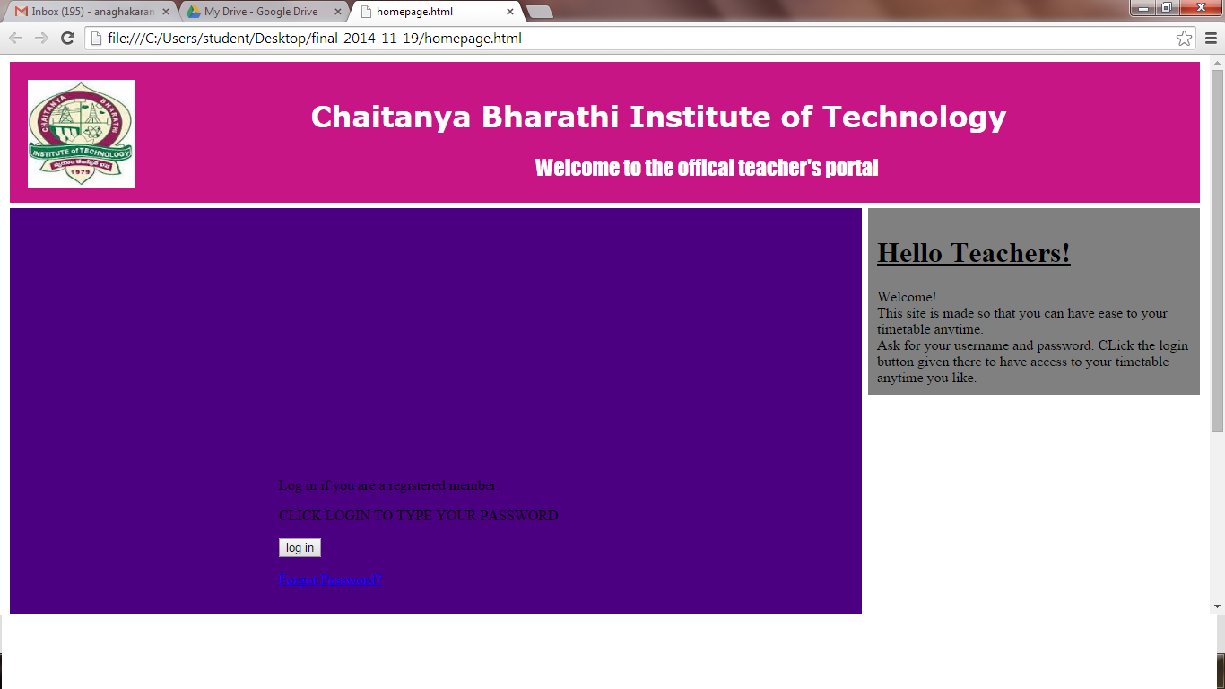
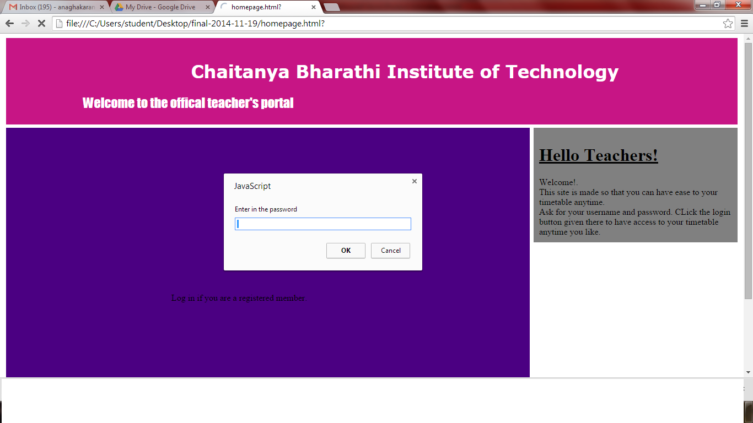
RESULT
Output screen of login pages

Slide 8
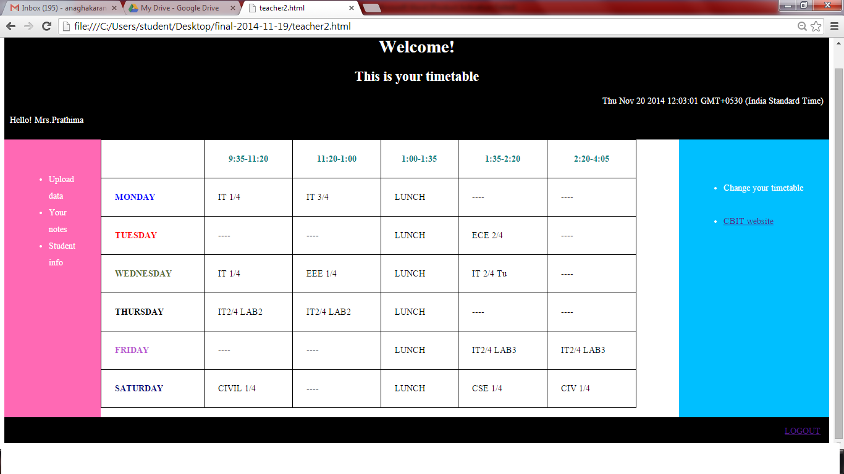
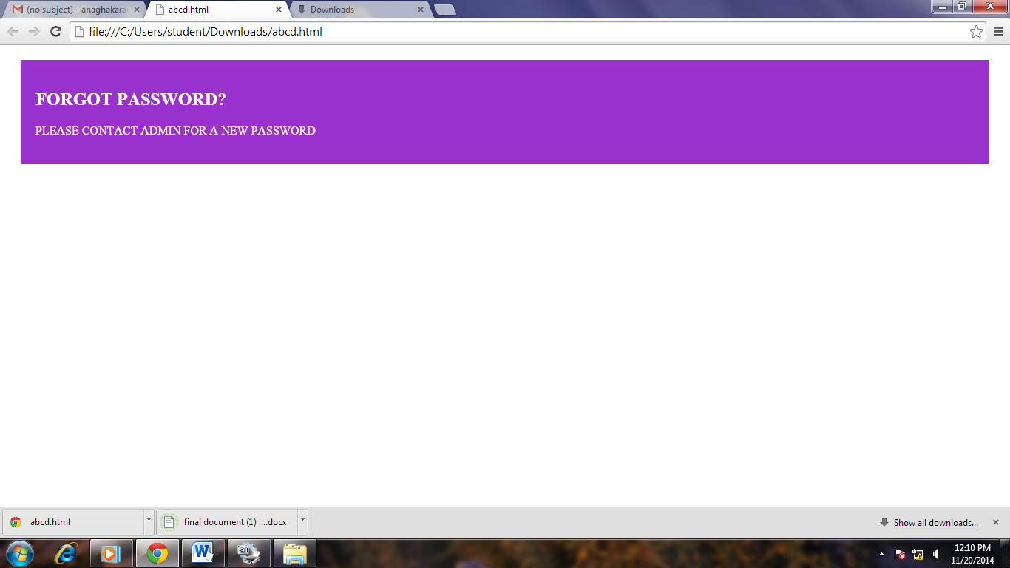
Output screen on login to a account
Output screen if forgot password

Slide 9
ADVANTAGES AND DISADVANTAGES
ADVANTAGES:
Reliable access
Systematic and colorful
Secured
Provides link to CBIT website
DISADVANTAGES:
Cannot update or modify the timetable.
Further registrations are not possible.

Slide 10
CONCLUSION AND FUTURE SCOPE
At present only few teachers who are already given an account are able to login, and in case they forget password, they have to contact the admin. But these can be resolved with future enhancements .
FUTURE SCOPE:
Being able to register and make your account and update it when required.
Change your timetable, upload notes and access to student information.
Get in touch with other teachers through this portal.

Slide 11
REFERENCES
www.wikipedia.org
www.w3schools.com
www.tutorialspoint.com
www.cppforschool.com

Slide 12
THANK YOU!

